Slide 1
Analyzing Neuroimaging Data Through Recurrent Deep Learning Models
Authors: Armin W. Thomas, Hauke R. Heekeren, Klaus-Robert Müller, Wojciech Samek
Presenter: Yaorong Xiao

Slide 2
Introduction
Challenges of applying DL models to neuroimaging data.
DeepLight framework
N-back task

Slide 3
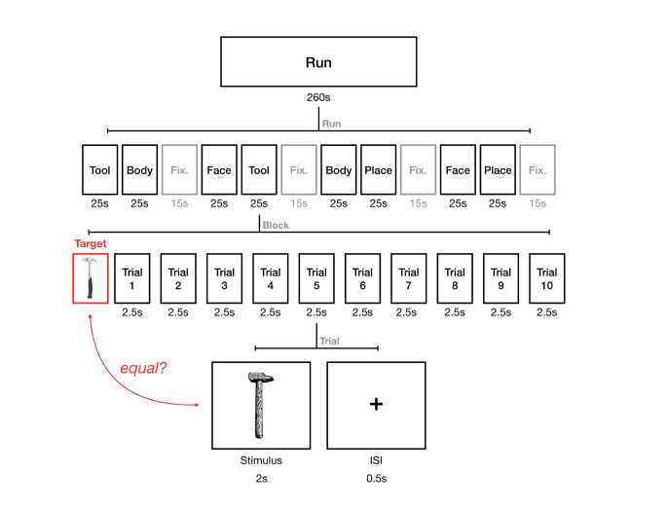
N-back task

Slide 4
Data Preprocessing
Volume-based smoothing
Linear detrending and standardization
Outer brain mask
100 subjects (70 for training, 30 for testing). 4 cognitive states.

Slide 5
Baseline Methods
General Linear Model (GLM)
Searchlight Analysis
Whole-Brain Least Absolute Shrinkage Logistic Regression

Slide 6
DeepLight Model
Convolutional neural network (CNN)
Long short term memory (LSTM)
Layer-Wise relevance propagation (LRP)

Slide 7
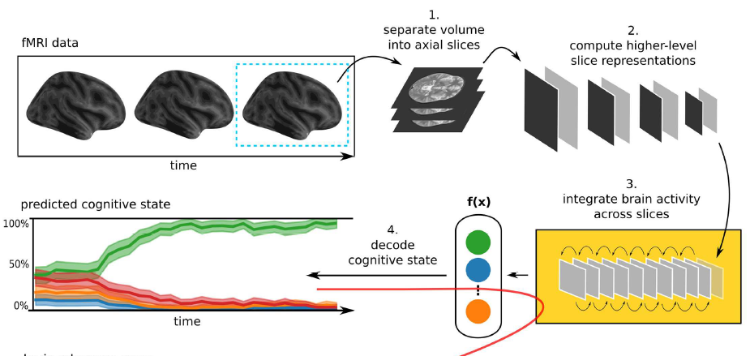
Framework of DeepLight

Slide 8


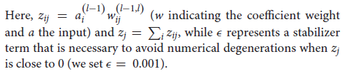
Layer-Wise relevance propagation

Slide 9
Training
60 epochs with ADAM optimization on tensorflow
Drop out

Slide 10
DeepLight brain maps
Working on correctly classified fMRI samples

Slide 11
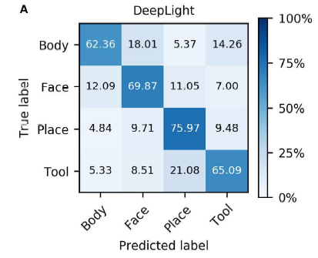
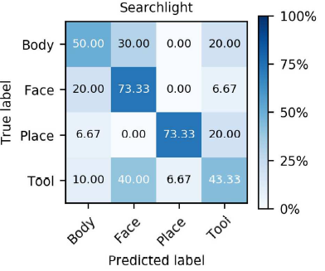
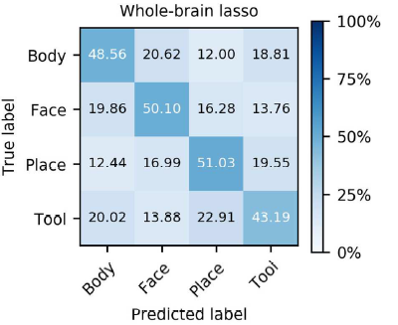
Experiment on decoding cognitive states (group-level)

Slide 12
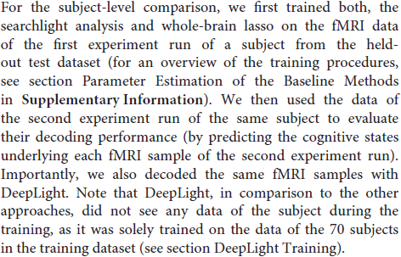
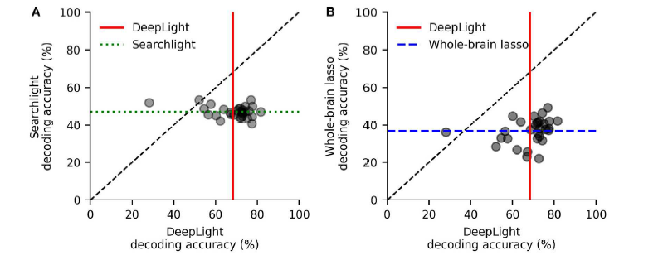
Subject-level

Slide 13
Association Brain Maps
Three models have different statistical interpretations.
Meta-analysis with NeuroSynth as benchmark
Results next slice

Slide 15
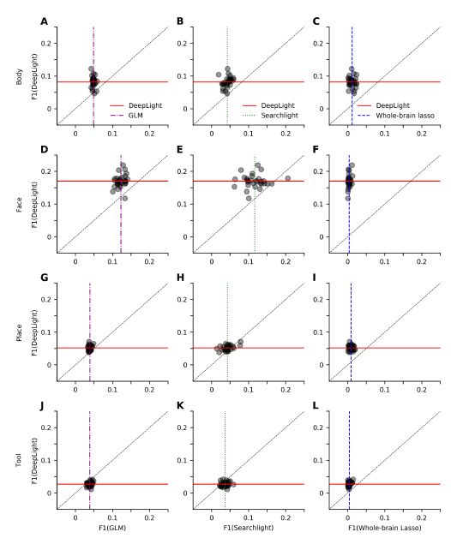
Subject-level Brain Maps
F1 score

Slide 16
Discussion
Good at association identification
Better learning ability
Learning through temporo-spatial variability
BUT:
The standard of their experiment comparison is confused and not convince.

